Slide 1
Lesson Seven
Conditionals

Slide 2
Skills
Use sensing commands to request user input
Use conditionals to add interactivity based on that input

Slide 3
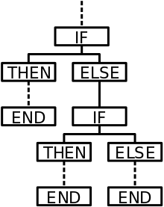
Conditional
A set of rules performed if a certain condition is met

Slide 4
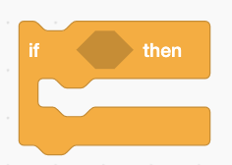
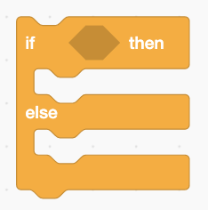
What’s the difference between
these two conditionals?
If criteria is met, something will happen
If criteria is met, something will happen. If criteria is not met, something else will happen.

Slide 5
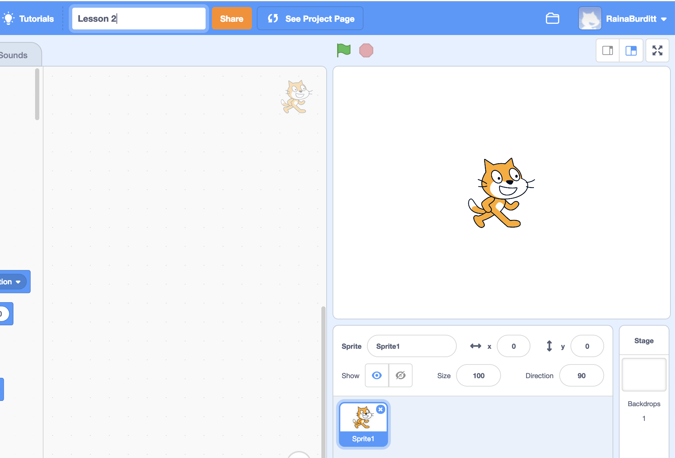
Create a new project
Title it Conditionals
Keep the cat!

Slide 6
We will write this interactive program

Slide 7
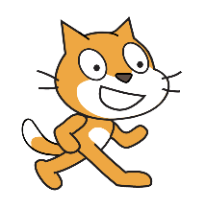
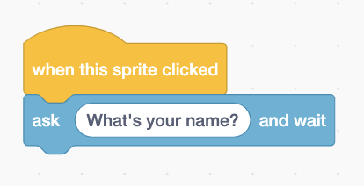
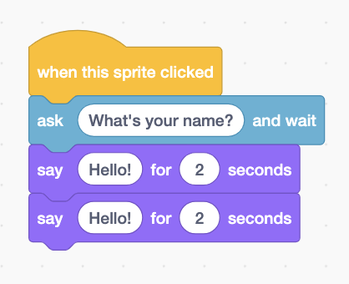
Start with when this sprite clicked trigger and add ask and wait code block
Add two say code blocks

Slide 8
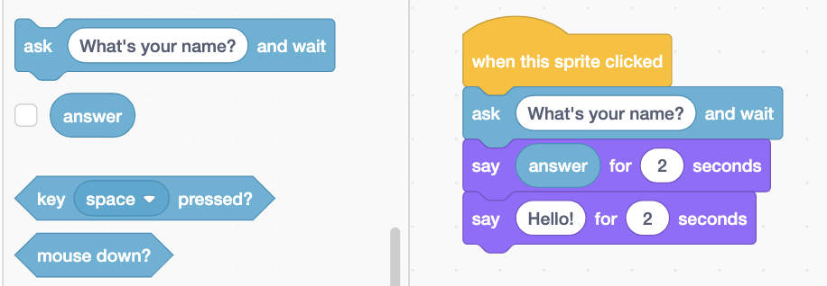
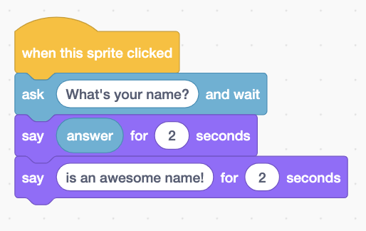
Drag answer into the text box
for your first say code block
Shorten to 0.5
This gives you the option to display the answer on the screen. Leave it unchecked for now.
Type:
is an awesome name!
Test it out!

Slide 9
Does it feel too choppy
happening in two word bubbles?
Delete your second “say” command

Slide 10
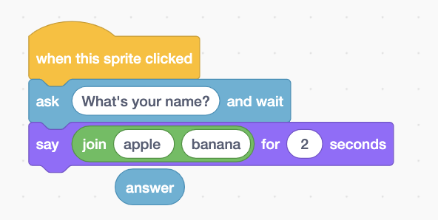
Drag join apple banana code
right on top of answer
It will replace it and answer will pop out

Slide 11
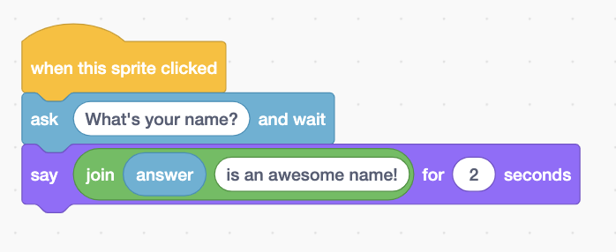
Drag answer on top of apple,
and type “is an awesome name” over banana
Now the cat will repeat whatever is typed by the user and the rest of the sentence all in the same word bubble.

Slide 12
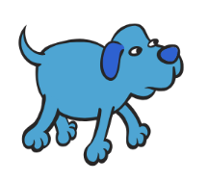
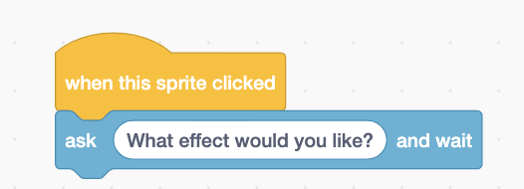
Add your dog sprite, his trigger, and his question

Slide 13
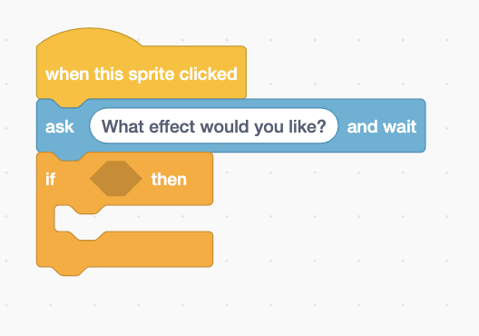
Add if…then code block

Slide 14
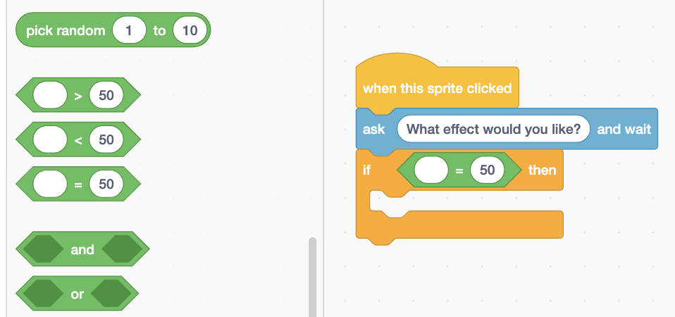
Drag into the hexagon

Slide 15
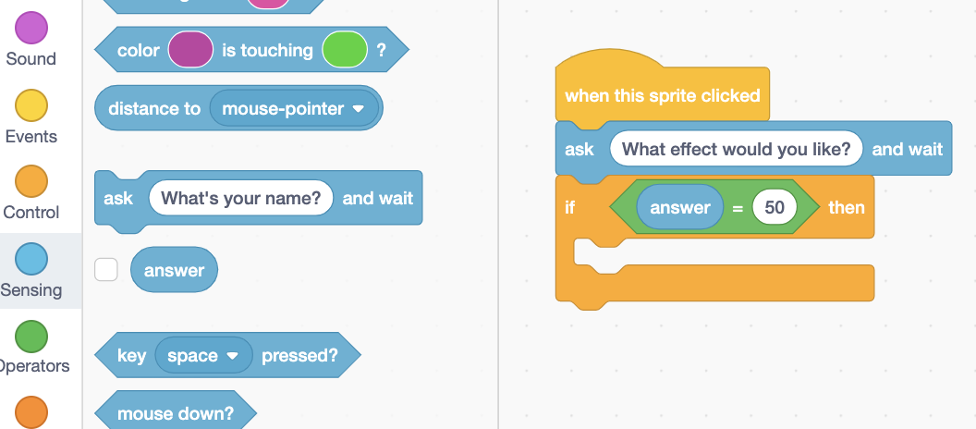
Drag answer into the first oval

Slide 16
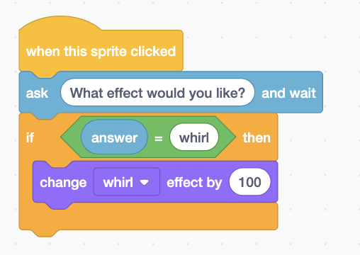
Write “whirl” in the second oval
Make sure there are no spaces around the word
Add a change whirl effect
(default is color, just click arrow to change)

Slide 17
What happens when you ask the dog to whirl multiple times?

Slide 18
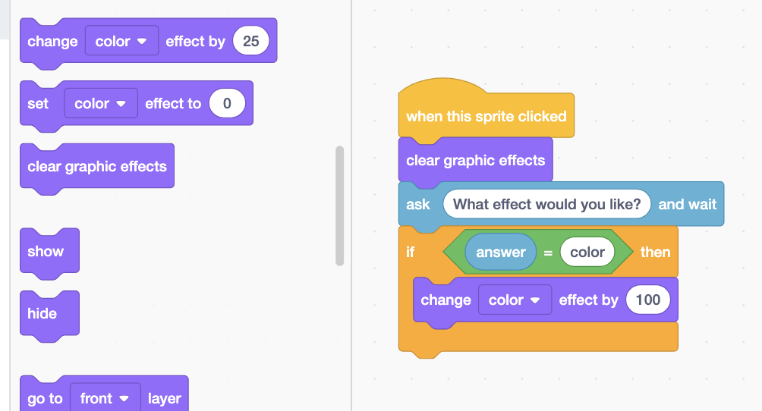
We need to add clear graphic effects right after our trigger so our dog will go back to normal
Can you program some more effects?
(color, mosaic, fisheye, pixelate)

Slide 19
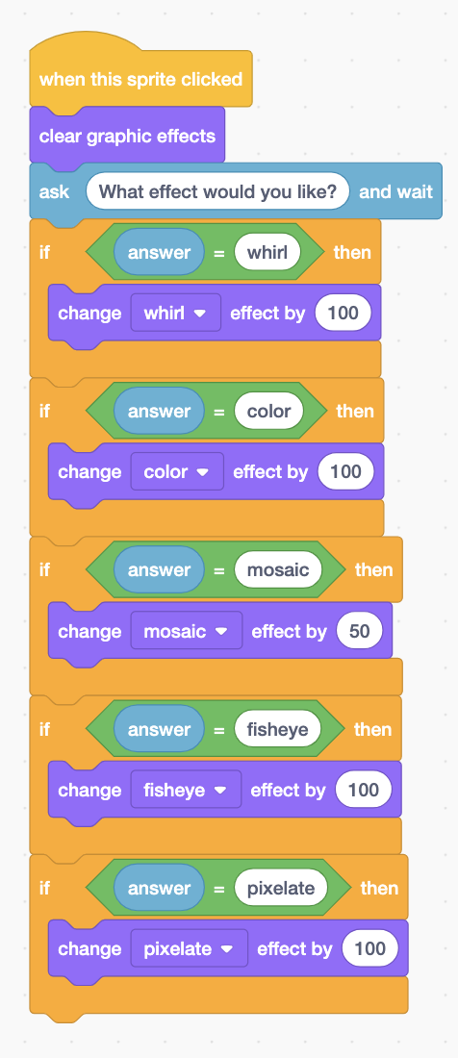
Solution

Slide 20
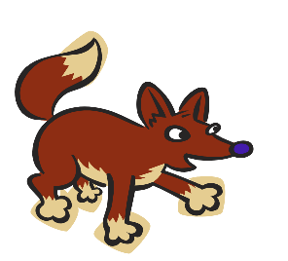
Can you code the fox?
He needs to ask you what the capital of Alaska is. If you say “Juno,” he should tell you that you are correct. If you say anything else, he should tell you that you are wrong.
You will need this code
Extra Challenges:
Add a background change to match the answer
Add a movement to match the answer
Add a sound effect to match the answer

Slide 21
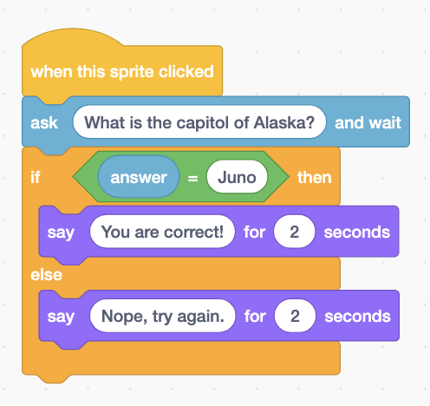
Solution

Slide 22
Your Turn!
Make an interactive study tool for one of your classes:
Must include at least 5 questions
User must be required to input information and then receive feedback
Incorporate some fun effects for right and wrong answers (still be kind for wrong answers)
Submit to Lesson 7 in the class studio.

Slide 23
12-Lesson Discounted Bundle
Bonus Files
Final project with
Guidelines
Rubric
Reflection Assignment
Student Support Website
A support page for each lesson to aid students while working independently
https://www.teacherspayteachers.com/Product/Computer-Coding-in-Scratch-10-Lessons-BUNDLE-3870547

Slide 24
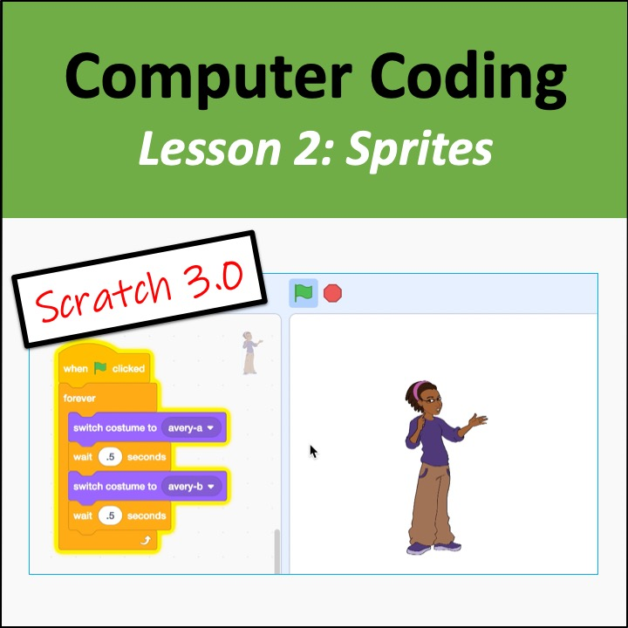
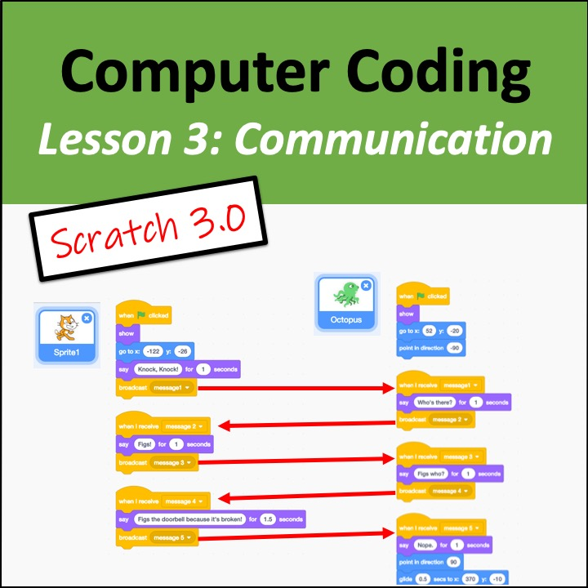
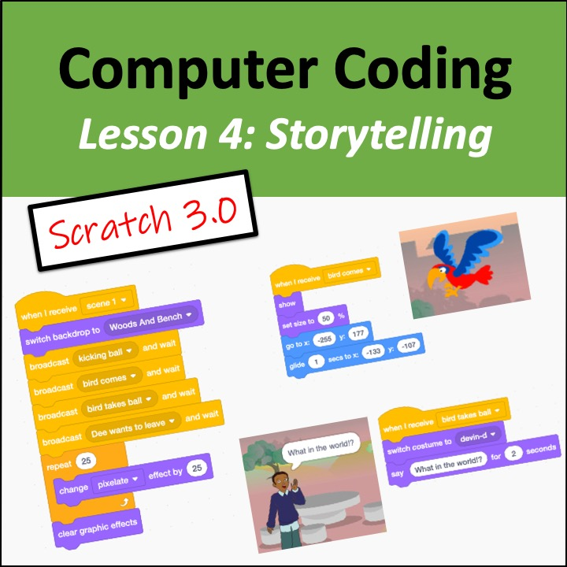
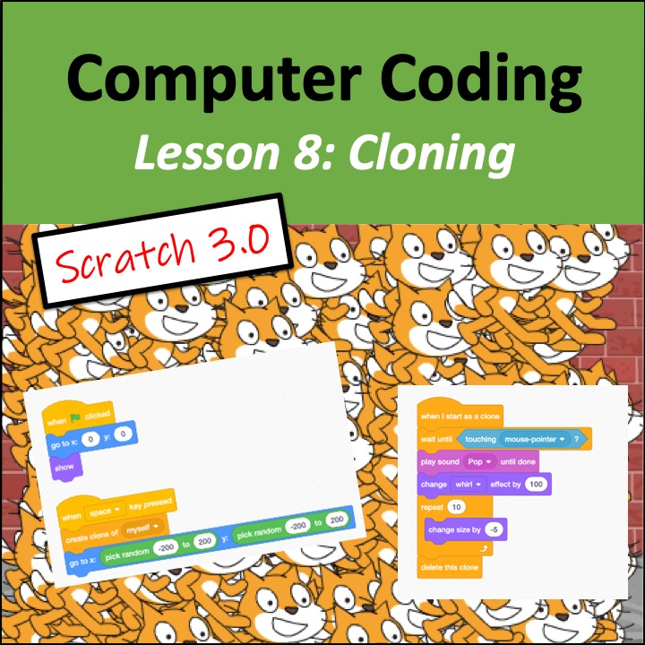
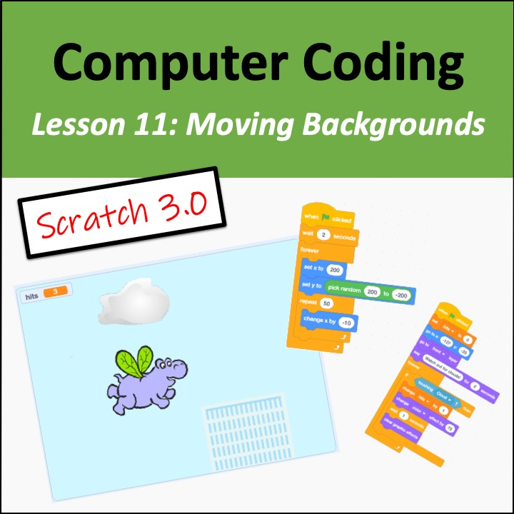
Click for individual lessons

Slide 25
Technology & Digital Design Lessons

Slide 26
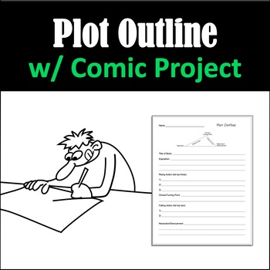
Literature, Writing, & Grammar Lessons

Slide 27
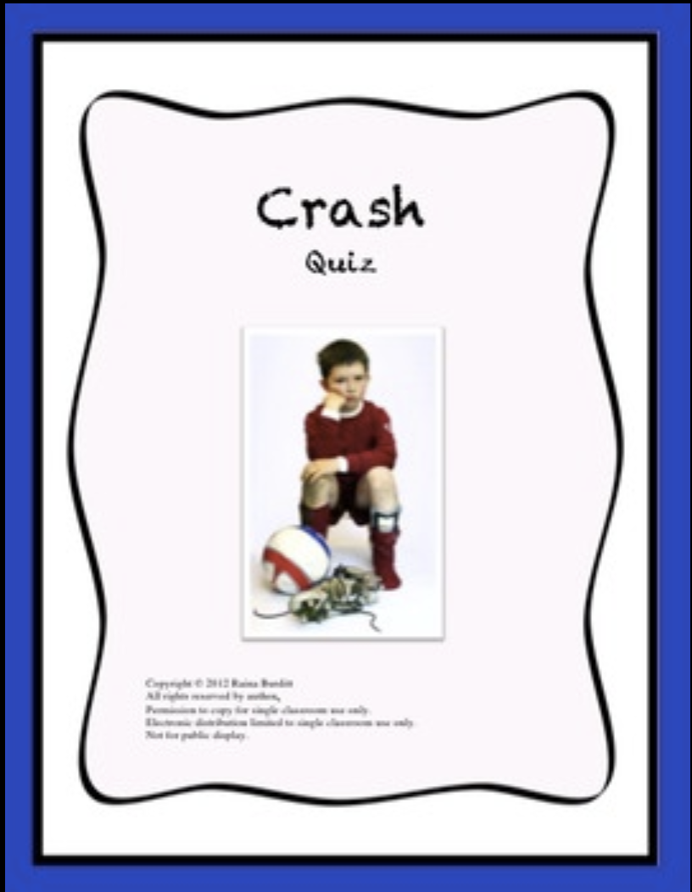
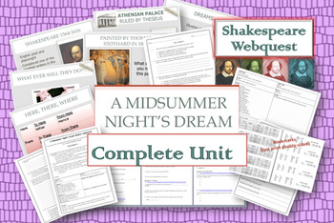
Novels

Slide 28
https://www.teacherspayteachers.com/Store/Miss-Bs-Shop

Slide 29
Terms of Use & Credits
By downloading this product you are given permission for classroom and personal use only. You may alter and modify this work for your own use, but please do not share, sell, or post online.
Please consider rating this resource. Your ratings earn you TpT credits to apply discounts towards future purchases. Use the link to go to the “My Purchases” tab and rate any products you have downloaded. Note that there is a separate “paid downloads” and “free downloads” tab. https://www.teacherspayteachers.com/My-Purchases
Cover art from Tangerine by Edward Bloor. Copyright ©1997 by Edward Bloor. Reprinted by permission of Houghton Mifflin Harcourt Publishing Company. All rights reserved.
All other images in products and on cover art (thumbnail images) were found in the public domain. The public domain consists of all the creative works to which no exclusive intellectual property rights apply. Those rights may have expired, been forfeited, expressly waived, or may be inapplicable.
Screenshots that are taken from Adobe CC Suite, Microsoft Office Suite, iMovie, and Scratch are in compliance with Fair Use guidelines.

